Slide 1
Syllable and Word Stress

Slide 2
Syllable
A unit of organization for a sequence of speech sounds
Comprises uninterrupted sound that can be used to make up words.
For example, the word hotel has two syllables: ho and tel. These will be marked here as in ho/tel.

Slide 3
Counting Syllables
To find the number of syllables in a word, use the following steps:
Count the vowels in the word
Subtract any silent vowels, (like the silent e at the end of a word, or the second vowel when two vowels are together in a syllable)
Subtract one vowel from every diphthong (diphthongs only count as one vowel sound.)
The number of vowels sounds left is the same as the number of syllables

Slide 4
Cont…
The number of syllables that you hear when you pronounce a word is the same as the number of vowels sounds heard. For example:
The word came has 2 vowels, but the e is silent, leaving one vowel sound and one syllable
The word outside has 4 vowels, but the e is silent and the ou is a diphthong which counts as only one sound, so this word has only two vowel sounds and therefore, two syllables

Slide 5
Why Syllables Are Important?
Knowing how to divide words into syllables can help:
improve reading skills
pronounce new, hard words
pronounce vowels
spell words correctly
Example:
Breaking “environmental” into syllables can help you read & pronounce it:
en-vi-ron-men-tal

Slide 6
Syllable Division Rules
Separate prefixes and suffixes from root words
examples: pre-view, work-ing, re-do, end-less, & out-ing
Are two (or more) consonants next to each other?
Divide between the 1st and 2nd consonants.
examples: buf-fet, des-sert, ob-ject, ber-ry, & pil-grim
Never split 2 consonants that make only 1 sound when pronounced together and aren't the same letter (i.e., 'ff').
examples: th, sh, ph, th, ch, & wh

Slide 7
Cont…
3. Is the consonant surrounded by vowels?
Does the vowel have a long sound? (Like the 'i' in line)
Divide before the consonant.
examples: ba-by, re-sult, i-vy, fro-zen, & Cu-pid
Does the vowel have a short sound? (Like the 'i' in mill)
Divide after the consonant.
examples: met-al, riv-er, mod-el, val-ue, & rav-age

Slide 8
Cont…
4. Does the word end with 'ckle'?
Divide right before the 'le.'
examples: tack-le, freck-le, tick-le, & buck-le

Slide 9
Cont…
5. Does the word end with 'le' (not 'ckle')?
Is the letter before the 'le’ a consonant?
Divide 1 letter before the 'le.'
examples: ap-ple, rum-ble, fa-ble, & ta-ble
Is the letter before the 'le’ a vowel?
Do nothing.
examples: ale, scale, sale, file, & tile

Slide 10
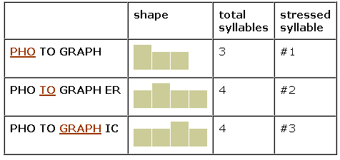
What is Word Stress?
In English, we do not say each syllable with the same force or strength. In one word, we accentuate ONE syllable. We say one syllable very loudly (big, strong, important) and all the other syllables very quietly
photograph, photographer, photographic

Slide 11
Other Examples
TEACHer, JaPAN,
aBOVE, converSAtion, INteresting, imPORtant,
deMAND, etCETera,
CHINa
The syllables that are not stressed are weak
The syllables that are stressed are strong

Slide 12
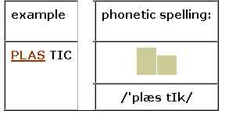
Where do I Put Word Stress?
The dictionaries giving the phonetic spelling of a word show which syllable is stressed, usually with an apostrophe (') just before the stressed syllable. Look at the example for the word plastic. There are 2 syllables. Syllable #1 is stressed.

Slide 13
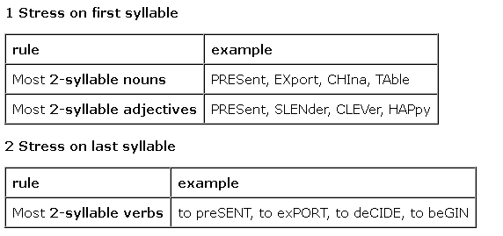
Rules of Word Stress in English
We can only stress vowels, not consonants

Slide 14
Cont..
There are many two-syllable words in English whose meaning and class change with a change in stress:
Word | Noun/Adjective | Verb
absent | ˈæb.sᵊnt | æb|ˈsent
conduct | ˈkɒn.dʌkt | kənˈdʌkt
present | ˈprez.ᵊnt | prɪ|ˈzent, prə-
content | ˈkɒn.tent | kənˈtent
desert | ˈdez.ət | dɪ|ˈzɜːt
perfect | ˈpɜː.fɪk|t | pəˈfekt, pɜː-
conflict | ˈkɒn.flɪkt | kənˈflɪkt

Slide 15
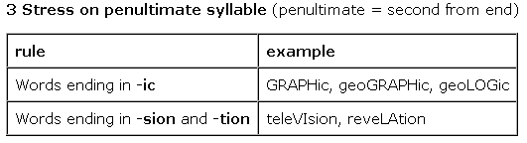
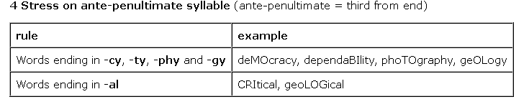
Cont…

Slide 16
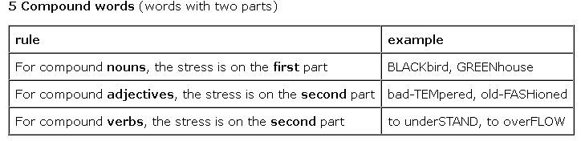
Cont..

